Slide 1
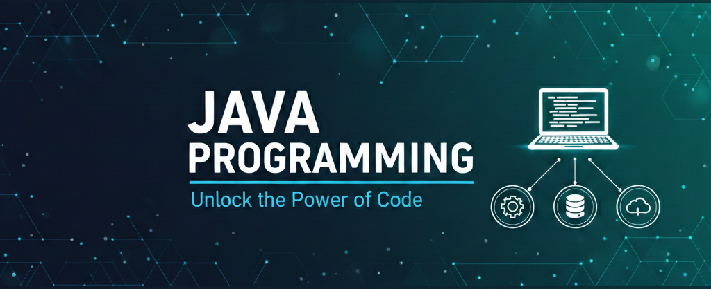
Introduction to Java
Presenter: Shubham Rawat

Slide 2

Session Objective:
To familiarize students with the Java programming environment, including its architecture, historical background, key features, and the steps involved in writing, compiling, and running Java applications.

Slide 3
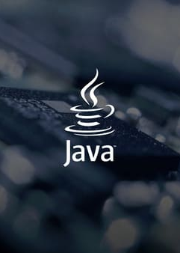
Topics Covered
What is Java?
History & evolution of Java
Features of Java (simple, secure, portable, robust, platform independent)
Difference between JDK, JRE, JVM
Java program execution model
Bytecode and Java Virtual Machine
First Java program structure
How Java compilation works
Setting up environment (IDE + JDK)

Slide 4
What is Programming?

Slide 5
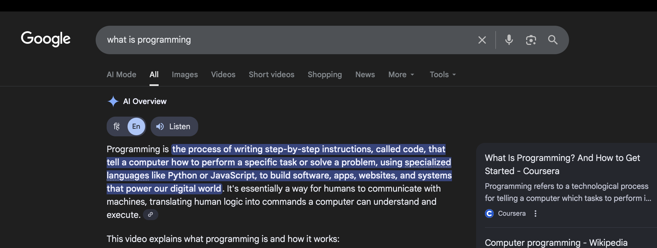

Slide 6
Steps to make Tea
01 | Boil Water
02 | Add Tea
03 | Pour Hot Water
04 | Steep
05 | Strain or Remove Tea Bag

Slide 7
What is Java?

Slide 8
Java
Java is a high-level, object-oriented programming language that has been a staple of the technology world since its release in 1995. Created by James Gosling at Sun Microsystems (now owned by Oracle), it was built with a revolutionary philosophy: "Write Once, Run Anywhere" (WORA).

Slide 9
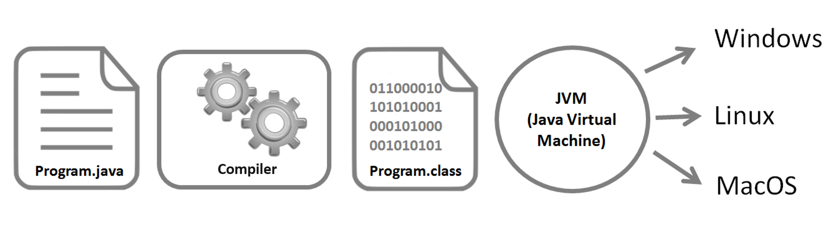
Write and Compile: A programmer writes Java source code in a file with a .java extension. The Java compiler (javac) converts this source code into platform-independent bytecode, which is stored in a .class file.
Run Anywhere: This same bytecode file (.class) can be transferred to any other system (e.g., Windows, macOS, Linux, Android).
Execution via JVM: Each operating system has its own specific implementation of the JVM. The JVM acts as an interpreter and runtime engine, translating the generic bytecode into the native machine code that the specific hardware and operating system can understand and execute.

Slide 10
Features of Java

Slide 11

Features of Java
Simple: Clean syntax (derived from C++) that removes complex features like explicit pointers and operator overloading for easier development.
Platform Independent: Compiled into Bytecode, allowing programs to "Write Once, Run Anywhere" (WORA) on any system with a JVM.
Secure: Protects systems using a sandbox execution environment and a bytecode verifier to prevent unauthorized memory access or viruses.
Robust: Ensures reliability through automatic garbage collection, strong type checking, and powerful exception handling to prevent crashes.
Portable: Architecture-neutral design ensures that Java applications run identically across different hardware and operating systems without modification.

Slide 12
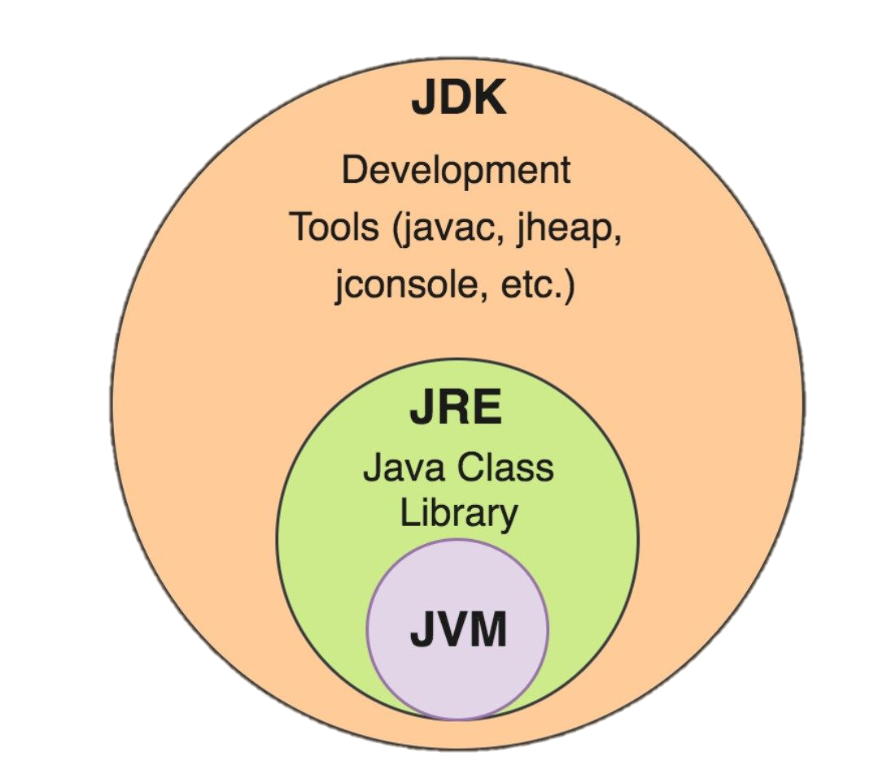
Section header
Difference between JDK, JRE, JVM

Slide 13
Difference between JDK, JRE, JVM
Java's Key Components:
JDK (Java Development Kit): The toolkit for developers.
JVM (Java Virtual Machine): The core that runs Java programs.
JRE (Java Runtime Environment): The runtime environment for executing
Why Learn About Java Architecture?
Understanding these components will help in developing efficient and
platform-independent Java applications.
Aspect | JDK | JRE | JVM
Purpose | To develop, compile, and run Java programs. | To provide an environment to run Java programs. | To execute Java bytecode into machine code.
Includes | JRE + Development Tools (compiler, debugger, etc.) | JVM + Class Libraries and supporting files | Core Execution Engine (interpreter, JIT, GC)
Platform | Platform-dependent (OS-specific installer) | Platform-dependent (OS-specific installer) | Platform-independent (bytecode runs on any JVM)

Slide 14
Section header
Java program execution model

Slide 15
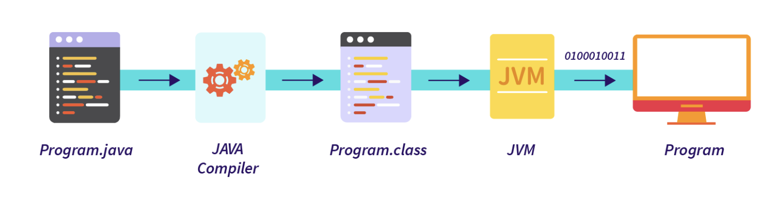
Java program execution model
Write code in .java file
Compile using javac → creates .class file (bytecode)
Run using java → JVM converts bytecode to machine code
Output is displayed

Slide 16
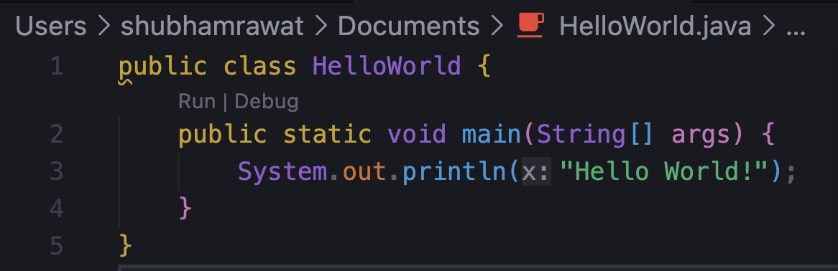
First Java Program (Hello World)
class name should match file name
main() is the entry point
System.out.println() prints output

Slide 17
Thank You

